Slide 1
Hybrid Cloud Backup, Recovery, and Migration (DRaaS)
Kris Swanson/Joe Losinski
Partner Technology Strategist

Slide 2
“Failure is ALWAYS an option.”
Adam Savage, MythBusters

Slide 3
Infallible truths (of cloud computing)
Software has bugs
Hardware will fail
Humans will make mistakes

Slide 4
How Ready are Businesses for Disruption?
“Only 18% of global disaster recovery decision makers and influencers feel very prepared to recover their data center in the event of a site failure or disaster”
“Much of the lack of preparedness is due to immature core planning processes, out-of-date plans, and very limited testing”
“While regulatory compliance continues to be important, the main driver of DR is the business need to stay online and competitive 24x7”
Stay Online
18%
Immature
Source: Forrester July 2017 The State of Business Technology Resiliency

Slide 5


Cause(s) of Significant Disaster Declaration(s)
56%
Source: Forrester/Disaster Recovery Journal November 2016 Global Disaster Recovery Preparedness Online Survey
38%
31%
19%
Systems
Failure
Power
Failure
Natural
Disasters
Cyber
Attack

Slide 6
Challenges implementing disaster recovery
Cost
Data center cost
Resource cost
Hardware cost
Complexity
Multiple data centers
Replication technologies/restore hardware
Managing management software
Reliability
Recovery of data
Providing service

Slide 7
Business continuity strategy—all three are important…
Primary region
Primary region
Secondary region
Original
Backup
High availability
Disaster recovery
Backup
Maintaining acceptable continuous performance despite temporary failures in services, hardware, datacenters or fluctuations in load.
Protection against loss of an entire region through asynchronous replication and failover of VMs to another cloud region using Azure Site Recovery.
Replication of data to one or more zones or regions so if your data is corrupted, deleted or lost you can restore it.
Notes:
High Availability
Essential for mission critical apps
Minimize data loss and downtime caused by application errors, planned maintenance and unplanned service incidents
Instant failover for max uptime
Replicate resources that run your applications in two or more locations within the same region with low latency
High Availability at a Glance
Scenario - Mission critical applications, where any downtime or loss of acceptable performance causes harm to the business or organization’s mission
Cost - Higher: due to running redundant infrastructure
Complexity - Higher: applications must architect for redundancy
SLA - Between 99.95% and 99.99%, depending on the solution
Azure platform options - Availability Sets, Virtual Machine Scale Sets (VMSS), Azure Availability Zones, any active-active replications.
Disaster Recovery
Protection from large scale failures with data residency
Maintain business continuity when an entire region is impacted. Azure regions are paired with a second region that shares data residency requirements, allowing you to stay protected and stay compliant
Get applications running again faster
Preconfigure replication and failover settings. If a disaster occurs, failover to your Azure subscription and run in the cloud. Failback when your original site is restored
Disaster Recover at a Glance
Scenario - Applications that need protection from large scale disasters, mission critical applications that can have a small amount of downtime during failover, applications that cannot be rearchitected for HA
Cost - Lower than high availability, but more costly than simple backups
Complexity - Lower level of complexity. Replication and failover settings must be configured, but applications do not need to be rearchitected
RPO and RTO - RPO between continuous replication to 15 minutes, RTO varies by source VM
Azure platform options - Azure Site Recovery or facilitated through a partner service
Backup
Cheapest protection option with data residency
Backup for applications and data is the cheapest protection option, since it does not factor in preconfiguring failover
Flexible options within Azure
VM backups are quickly and easily configured with Azure Backup, and choose storage account replication options at the time of setup
Backup at a Glance
Scenario - Protection for applications and data that do not need to be recovered quickly (hours instead of minutes) in the event of a disaster or service interruption
Cost - Lowest cost protection option
Complexity - Lowest level of complexity
RPO and RTO - RPO is configurable and varies by source, and RTO will be high (hours to days) since new infrastructure needs to be deployed and setup
Azure platform options - Azure Backup, storage redundancy (LRS, ZRS, GRS), VM snapshots

Slide 8
RTO and RPO
Recovery Time Objective (RTO)
“The recovery time objective (RTO) is the targeted duration of time and a service level within which a business process must be restored after a disaster (or disruption) in order to avoid unacceptable consequences associated with a break in business continuity.”, https://en.wikipedia.org/wiki/Recovery_time_objective
Recovery Point Objective (RPO)
“A recovery point objective, or “RPO”, is the maximum targeted period in which data might be lost from an IT service due to a major incident. The RPO gives systems designers a limit to work to.”, https://en.wikipedia.org/wiki/Recovery_point_objective
RPO
RTO
PTO*
Disaster
Lost Data
Down Time
*PTO: Take some time off. You’ve earned it. ☺

Slide 9

Picking RPO and RTO
RPO and RTO are a business decision
Get your current RPO and RTO
Test options and estimate costs
Get business owner agreement on RPO and RTO
Implement & measure

Slide 10
Achieving RTO and RPO
You need all three
Original
Backup
Primary site
Primary site
Secondary site
DATA
DATA
Backup
High availability
Disaster recovery
When your data is corrupted, deleted or lost you can restore it
When your applications have a catastrophic failure, run a second instance
When your applications have a catastrophic failure, run them in Azure or a secondary datacenter

Slide 11
Recovery Services Vault

Slide 12
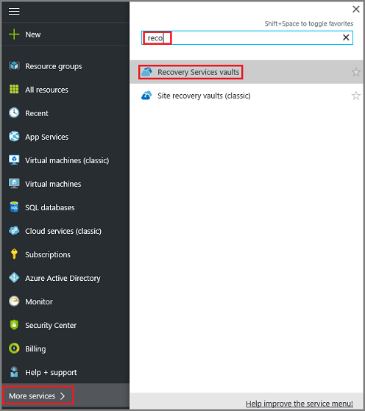
Recovery Services Vaults
A Recovery Services vault is an entity that stores all the backups and recovery points you create over time. The Recovery Services vault also contains the backup policy applied to the protected files and folders.

Slide 13
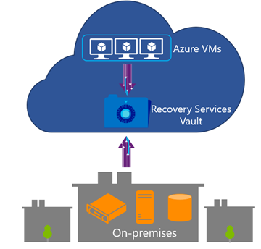
Recovery Services Vaults
Application consistent backup for Windows Azure VMs and File-system consistent backup for Linux Azure VMs without the need to shutdown VM
Bottomless Recovery Services vault to eliminate storage management complexity for backup
Efficient and reliable backups to the cloud and in the cloud
No backup infrastructure maintenance
Geo-Redundant

Slide 14
Recovery Services Vaults
Key Decisions for creating a RSV
Number of Vaults
Location
Storage Replication Type

Slide 15
Azure Backup

Slide 16
Azure Backup by the numbers…
3 PB
200,000+
195,000
Added every week
IaaS VMs
On-premises servers protected
100 PB
85%
60,000
Azure Backup Storage
Azure TOP Customers are Azure Backup customers
Customers

Slide 17











Conventional backup approaches
Custom Scripts
SQL Native backups
Backup Software
VM snapshots
Azure Storage
Azure Storage
File snapshots
Need to manage Infrastructure
No Central Management
Need to manage Infrastructure
Some Central Management

Slide 18

Azure Backup
Simple and reliable cloud integrated backup as a service
Compelling cloud-based backup alternative to tape
Secure and reliable backup as a service
Efficient and flexible online backup services
Azure
Azure
Agent F
Azure Backup
Virtual Machines
State / Config
Commvault Simpana
Azure Storage (blob)
Virtual Machines
VPC / tenant
Restore
VPC / tenant
Restore
Option 1 – Use native Azure Backup
Option 2 – Use 3rd party backup apps

Slide 19


Azure Backup – Architecture matters
Scale-Up Within the enterprise
Azure Backup Service
Data
Plane
Recovery Point Management
Data Pruning
Backup Extension
Storage Management
Data Packing
Scale-Out Across Customers
Backup Extension`
Authentication
Policy Management
Monitoring
&
Reporting
Access Control
Management
Plane
No infrastructure
Enterprise scale
Extensible
Central management

Slide 20
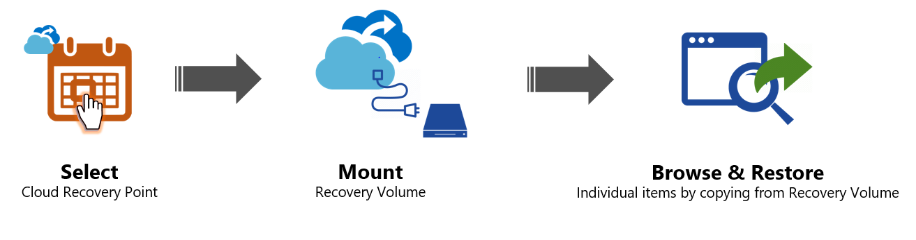
Azure Backup – Restore as a Service
Unified Restore experience
Instant recovery
Open and view data before restore
Zero additional infra or cost

Slide 21


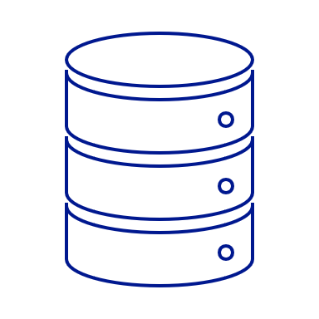
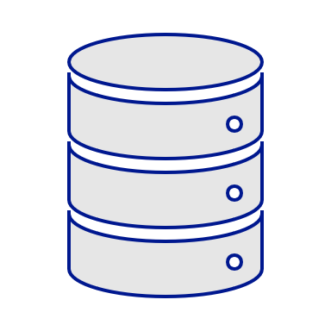

Azure Backup – Restore-as-a-Service
Azure Backup Service
Data Plane
Azure VM
Recovery
Services Management
iSCSI Connection
iSCSI Initiator
iSCSI Target
.VHD Snapshots
iSCSI Connection
iSCSI Target
iSCSI Initiator
.VHD Snapshots
Azure Backup Agent
On-premises server
No infrastructure
Inspect before Restore
Consistent

Slide 22
Time-to-first-byte Improvements : Instant Restore!
Up until now for smaller size DS
Recovery Point
Volume
Metadata VHD Isolation
Full DS Reverse-Transformation
VHD creation for Selected Items
Time consuming part for large DS as the entire volume is reverse transformed for the first byte
Decryption
Decompression
First byte recovered!

Slide 23

Time-to-first-byte Improvements : Instant Restore!
Up until now for smaller size DS
Instant restore of Large DS items
Recovery Point
Volume
Recovery Point
Volume
Metadata VHD Isolation
Metadata VHD Isolation
Full DS Reverse-Transformation
Mount recovery point as Disk
(iSCSI)
VHD creation for Selected Items
Explore and select item(s)
Decryption
On-demand Reverse-Transformation
(without VHD Creation)
Time saving
Decompression
First byte recovered!
First byte recovered!

Slide 24
Instant Restore impact!
Drastic reduction in first byte recovered!
Datasource / Machine Characteristics | Time to first byte (without Instant Restore) | Time to first byte (With Instant restore)
200 GB | 30 mins | < 2 mins
1 TB | 3 hours | ~5 - 7 mins
4TB | 8 hours | ~10 - 12 mins
15x faster
~30x faster
~40x faster

Slide 25


Azure Backup – Sending (large) data efficiently
Offline Seeding
Several TBs
10 TB
Azure
Import
Service
Recovery Services Vault
Compression
Ship
Azure Backup
agent
Backup data
10 TB
Bitlocker encrypted
30 – 40% Reduction in size
Savings in network bandwidth & in time

Slide 26
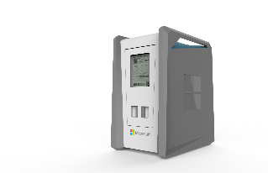
Azure Backup – Sending (large) data efficiently
Recovery Services Vault
Ship
Azure Data Box Service
(Preview)
Azure Data Box
Up to 100 TB
Backup data from multiple sources
No procuring of disks
Parallel transfers
Safe and secure

Slide 27
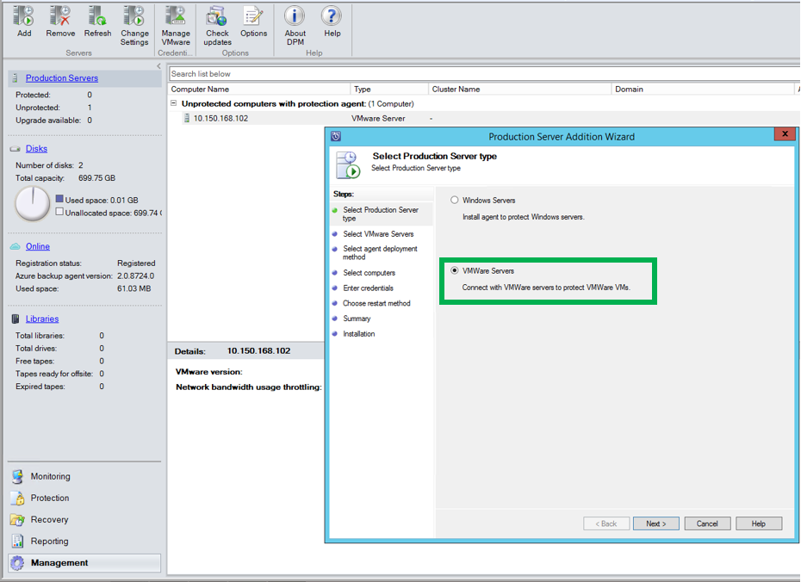
VMWare VM Backup
Agentless Backup
Cloud integrated
Discovery of vCenter
vCenter 5.5, 6.0, 6.5 support
Folder-level Auto protection
Protect VMs stored on NFS/SAN/DAS
Available through MABS

Slide 28
Azure Backup Server

Slide 29
Azure Backup Server (MABS)
Designed to address the protection of data at the workload level
Functionally equivalent to System Center Data Protection Manager except:
No integration with System Center components
No support for tapes
Requires an active Microsoft Azure subscription (and not a System Center license)

Slide 30
Feature Comparison
Component | Benefits | Limits | What is protected? | Where are backups stored?
Azure Backup (MARS) agent | Back up files and folders on physical or virtual Windows OS (VMs can be on-premises or in Azure) No separate backup server required. | Backup 3x per day Not application aware; file, folder, and volume-level restore only, No support for Linux. | Files Folders | Recovery Services vault
Azure Backup Server | App aware snapshots (VSS) Full flexibility for when to take backups Recovery granularity (all) Can use Recovery Services vault Linux support on Hyper-V and VMware VMs Back up and restore VMware VMs Does not require a System Center license | Cannot back up Oracle workload. Always requires live Azure subscription No support for tape backup | Files Folders Volumes VMs Applications, Workloads | • Recovery Services vault, • Locally attached disk

Slide 31
How does Azure help with High Availability?

Slide 32
Availability Sets
Protect against planned and unplanned events
Azure distributes the placement of VMs across the underlying infrastructure
Fault Domains
share a common power source and network switch
Update Domains
Intelligently update the host OSs that your guest VMs are running on

Slide 33
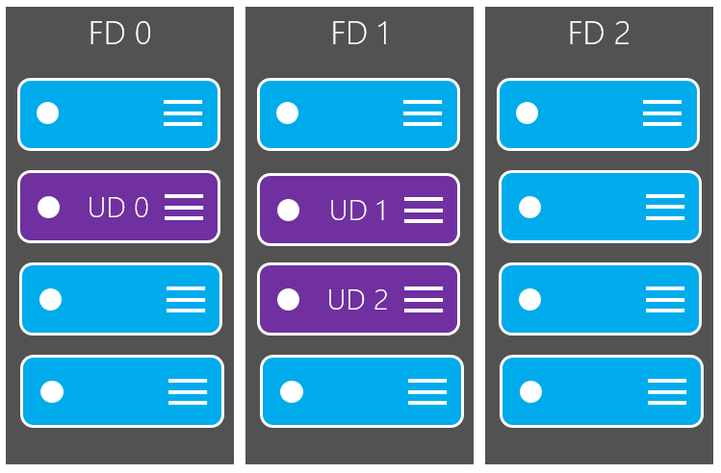
Availability Sets

Slide 34
How does Azure help with Disaster Recovery?

Slide 35
High availability and disaster recovery
What is one key difference between Disaster recovery and high availability?
Disaster recovery begins where high availability ends

Slide 36
High availability and disaster recovery
Disaster recovery begins where high availability ends
Virtual machine (app)
Server (app)
Availability set (HA)
Cluster (HA)
Paired region (DR)
2nd site (DR)

Slide 37





Azure Site Recovery: The Complete Disaster Recovery Solution
Site to Azure
Site to Site
Any Cloud
AWS*
Physical/VMware to VMware
VMware
Hyper-V
Physical
VMM to VMM
Any OS
Windows
Linux

Slide 38
Azure Site Recovery

Slide 39
Business Continuity Via Azure Site Recovery
Get your business back up and running in minutes with near-zero data loss
Use Azure as your DR site
Automated VM protection & replication
Remote health monitoring
Customizable recovery plans
No-impact recovery plan testing
Orchestrated recovery of tiered applications
On-premises to Microsoft Azure protection
Microsoft Azure Site Recovery
Orchestration & Replication
Primary Site
Windows Server

Slide 40

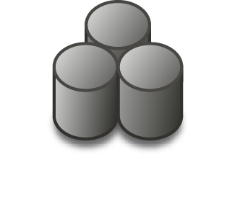
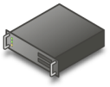
Hyper-V
Headquarters

Slide 41
Hyper-V Replica
Headquarters
Remote Location

Slide 42
Azure Site Recovery
Headquarters
Azure

Slide 43


Azure Site Recovery One solution for multiple infrastructures
Replication
Replication
SAN
SAN
Replication
Hyper-V
Microsoft Azure
Hyper-V
Hyper-V
Hyper-V
Hyper-V
1
Hyper-V to Hyper-V (on-premises)
2
Hyper-V to Hyper-V (on-premises)
3
Hyper-V to Microsoft Azure
Replication
Replication
Replication
Microsoft Azure
Microsoft Azure
Microsoft Azure
VMware or Physical
VMware
VMware or Physical
4
VMware or Physical to VMware (on-premises)
5
VMware or Physical to Microsoft Azure
6
Microsoft Azure to
Microsoft Azure
Protect important applications by coordinating the replication and recovery of private clouds across sites. Protect your applications to your own second site, a hoster’s site, or even use Microsoft Azure as your disaster recovery site.

Slide 44

Azure Site Recovery Disaster Recovery + Migration
VMware
Hyper-V
Physical
Failover from your data center
Failover between regions in Azure

Slide 45


Migrate Servers to Azure
Migrate from multiple environments
VMware, Hyper-V, physical, Azure and Amazon Web Services
No-impact migration testing
When replicating workloads into Azure, execute tests to ensure readiness
Move applications with near-zero downtime
Move a single application or an entire datacenter to the cloud with minimal impact to production users

Slide 46
Azure Site Recovery Migrate applications to Azure IaaS with confidence
Zero application data loss during migration
Near-zero application downtime during migration
Broad coverage for hypervisors, applications, operating systems, and Azure features
No-impact application testing in Azure
Free!

Slide 47

Disaster Recovery for Hyper-V
Hyper-V Server
Azure Site Recovery
443 (HTTPS)
Microsoft Azure
Data Channel
Public Internet or ExpressRoute with Public Peering
Source: Hyper-V
Microsoft Azure Recovery Services Agent
Replicates data to Azure
Documentation: https://aka.ms/asr_hyperv
Videos: https://aka.ms/asr_videos

Slide 48
Disaster Recovery for VMware
443 (HTTPS)
Config Server
Process Server
9443 (HTTPS)
Azure Site Recovery
443 (HTTPS)
Microsoft Azure
Data Channel
Public Internet or ExpressRoute with Public Peering
Source: VMware, AWS & Physical Servers
Process Server
Used for caching, compression, and encryption
Configuration Server
Used for centralized management
Mobility Service Captures all data writes from memory
Documentation: http://aka.ms/asr_vmware
Videos: https://aka.ms/asr_videos

Slide 49

Application DR with ASR
Azure Site Recovery
DR Orchestration
DR Orchestration
DB Tier
ASR Replication
Azure Storage
App Tier
Web Tier
ASR Replication
Active Directory
ASR Replication
Primary Site
Azure

Slide 50
Application DR with ASR
Azure Site Recovery
DR Orchestration
DR Orchestration
DB Tier
IaaS VM
SQL Availability Group
App Tier
Web Tier
ASR Replication
Azure Storage
Active Directory
AD & ASR Replication
IaaS VM
S2S VPN
Azure
Primary Site

Slide 51



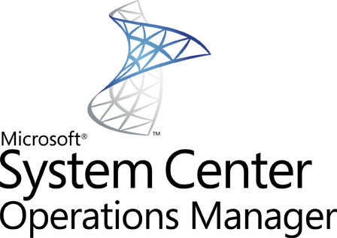



Unmatched Application Support
Active Directory | IIS | RDS/VDI | File Server
Only Disaster Recovery Solution backed by Microsoft Support for Microsoft Applications

Slide 52
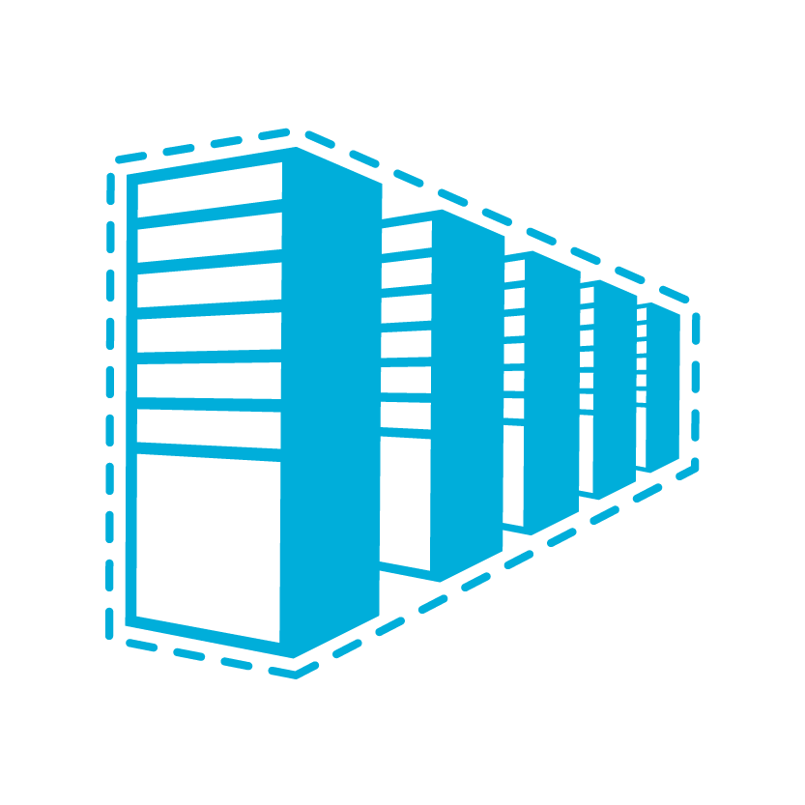
ExpressRoute
The amount of data being sent to Azure will depend on the rate of change (after the initial seeding of data)
The reliability of that connection is paramount
Customer’s
dedicated
connection
Azure Public Services
Connectivity provider
infrastructure
Azure Edge
Customer’s network
Azure Compute
Public Peering
Traffic to public Azure IP addresses
Private Peering
Traffic to Azure Virtual Networks
Traffic to Azure Virtual Networks after failover

Slide 53
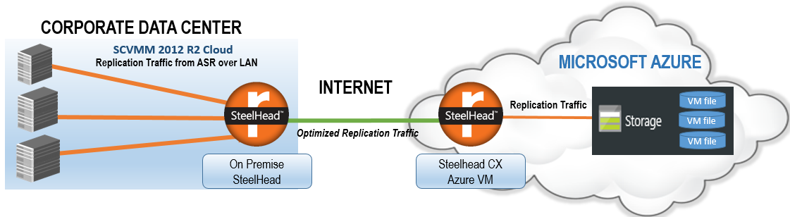
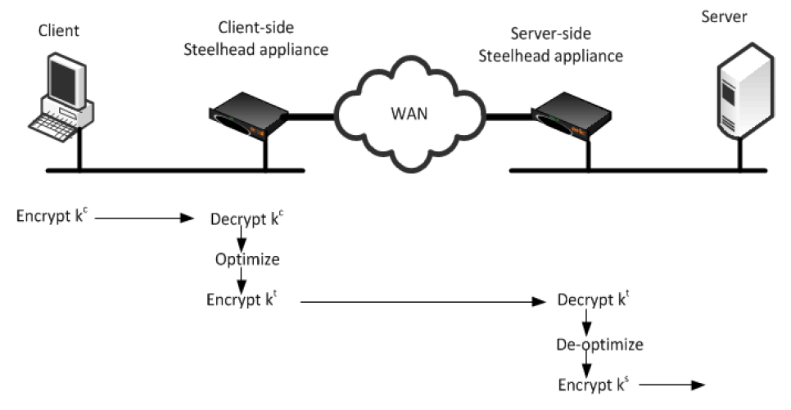
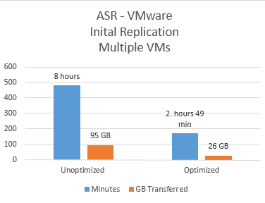
ASR with Riverbed
Data Reduction
Average: 72.1%
Peak: 99.7%
3.6x capacity increase
LAN Throughput
Total: 95.4 GB
WAN Throughput
Total: 26.6 GB
Source: Microsoft and Riverbed whitepaper: https://gallery.technet.microsoft.com/Optimizing-Azure-Recovery-8da50893

Slide 54
Disaster Recovery for VMware
443 (HTTPS)
Config Server
Process Server
9443 (HTTPS)
Azure Site Recovery
443 (HTTPS)
Microsoft Azure
Data Channel
Public Internet or ExpressRoute with Public Peering
Source: VMware, AWS & Physical Servers
Process Server
Used for caching, compression, and encryption
Configuration Server
Used for centralized management
Mobility Service Captures all data writes from memory
Documentation: http://aka.ms/asr_vmware
Videos: https://aka.ms/asr_videos

Slide 55
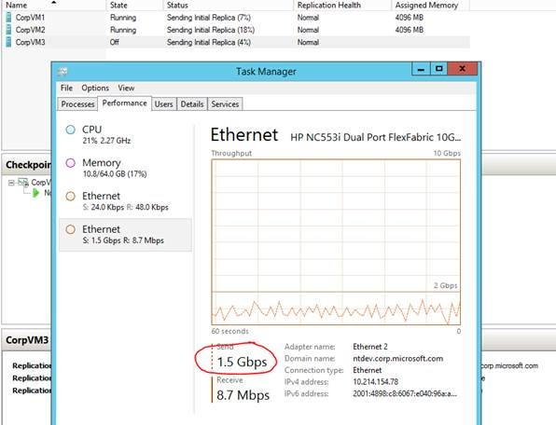
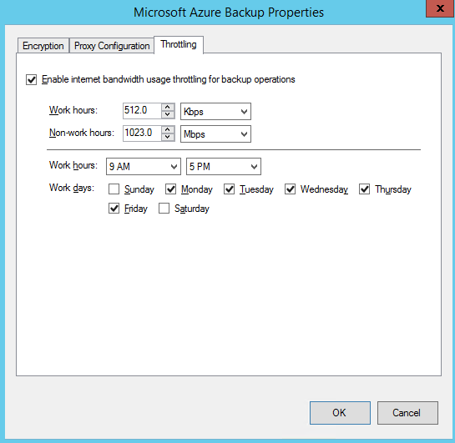
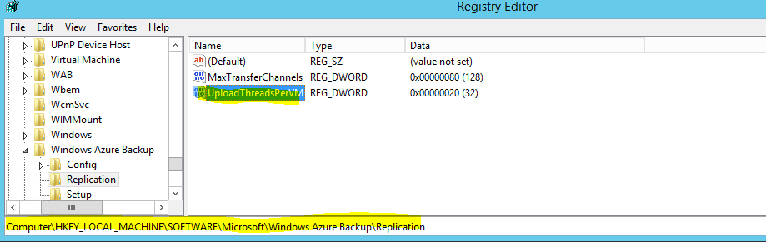
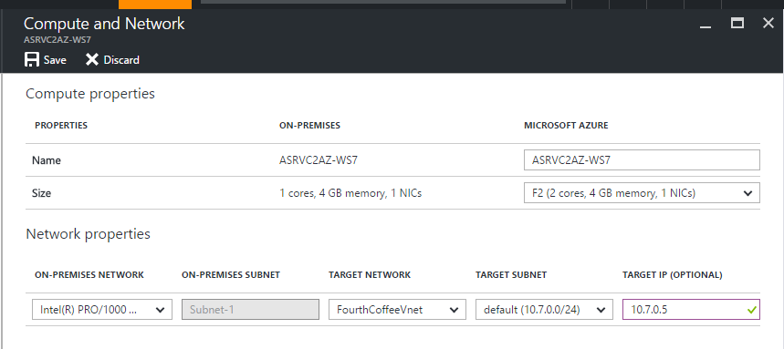
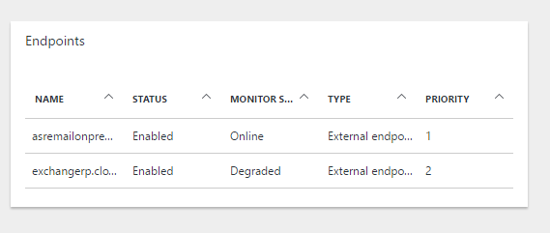
Networking – Best Practices
Saturate Available bandwidth
Throttling
First class experience with MARS agent – More details
Retain IP vs. Change IP
With full subnet failover -> Retain IP
For partial subnet failovers -> Change IP
More details
Client routing
ASR + Azure Traffic Manager - More details

Slide 56
Capacity Planning – THE Best Practice
Network bandwidth
Initial Replication
Delta Replication & Peaks
Storage
Replication
Workload IOPS during failovers
Test Failover (Replication and Workload IOPS simultaneously)
Standard or Premium Storage
Storage account naming convention
Compute Capacity
Test Failover to ensure necessary capacity

Slide 57
Capacity Planning – THE Best Practice
Separates the men from the boys
Real partners use planning tools
ASR Deployment Planner for Hyper-V to Azure
ASR Deployment Planner for VMware to Azure

Slide 58

Azure Migrate

Slide 59
Vision
Make it easy for customers to migrate to Azure
Discover -> Migrate -> Optimize
Virtual machines, Databases, Data, Apps etc.
No additional cost

Slide 60



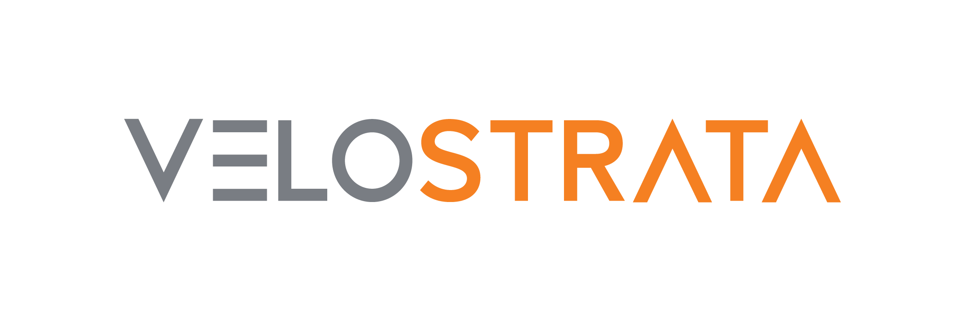








Landscape – Future
Discover
Migrate
Optimize
Microsoft
Azure Migrate
Azure Site
Recovery
Database Migration
Service
Operations
Management Suite
Database Migration
Assistant
Partners

Slide 61
Benefits
Discovery
Appliance-based
Light: Non-intrusive, Frictionless
Deep: High-confidence
Assessment
Azure suitability
Right sizing
Cost estimation

Slide 62
Appliance-based
No pre-setting or pre-configuring a machine
No installation of pre-requisite software

Slide 63
Light discovery
No agents to install and no firewall ports to open
No machine creds (host or guest)
No privileged creds (virtualization manager)
No waiting to gather performance history

Slide 64
Deep discovery
Agent-based
No guesswork anymore
No need to remember which machine belongs to which app

Slide 65
Suitability
Can I host this machine in Azure?

Slide 66
Rightsizing
What’s the best VM size based on performance history?

Slide 67
Cost
How much would the recurring cost be?

Slide 68

Details
Raw metadata
Processed metadata
Collector VM
Azure Migrate Service
Azure Migrate Portal
2. Start discovery
Raw metadata
1. Download and configure appliance
vCenter Server
User
ESXi hosts and VMs

Slide 69
Details
Raw metadata
Processed metadata
Collector VM
Azure Migrate Service
Azure Migrate Portal
Assessment
2. Start discovery
Raw metadata
3. Create assessment
1. Download and configure appliance
vCenter Server
User
ESXi hosts and VMs

Slide 70
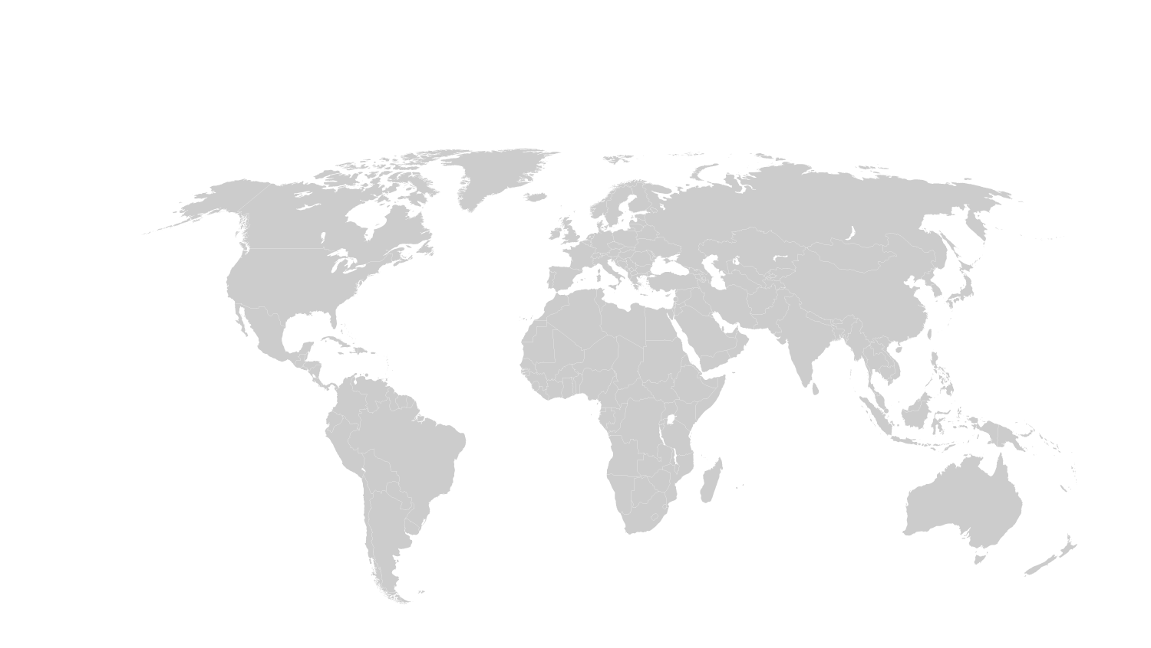
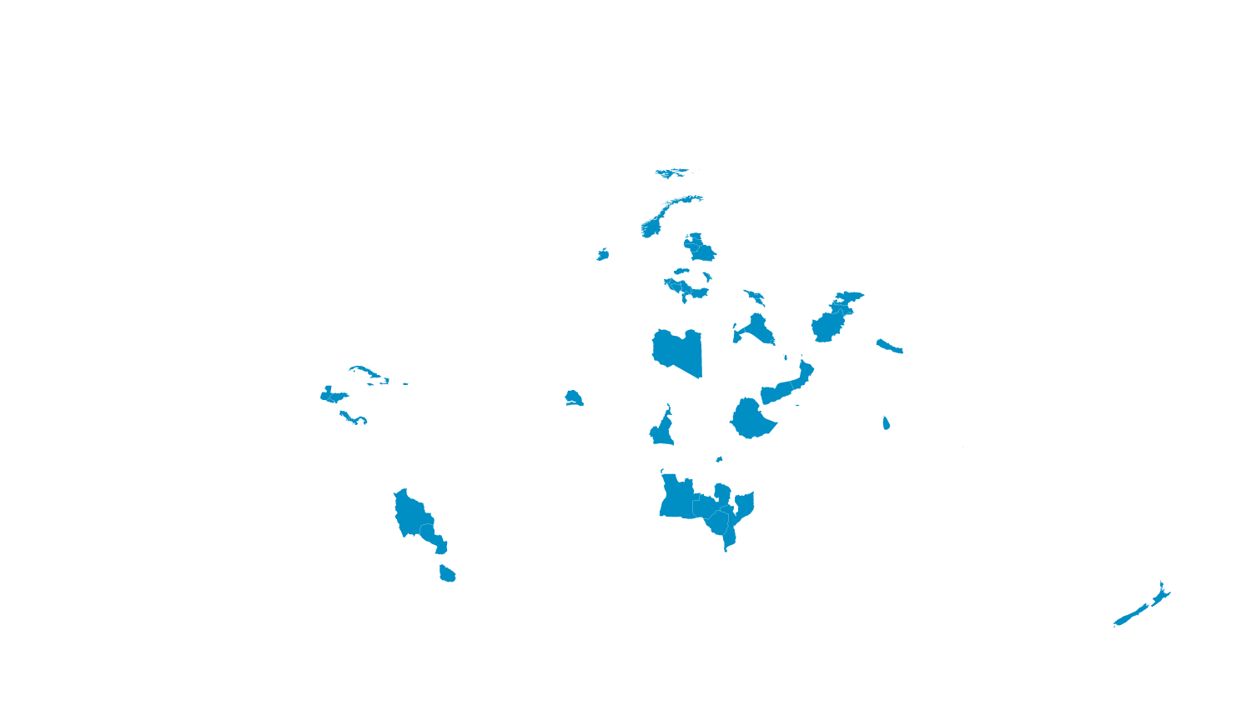
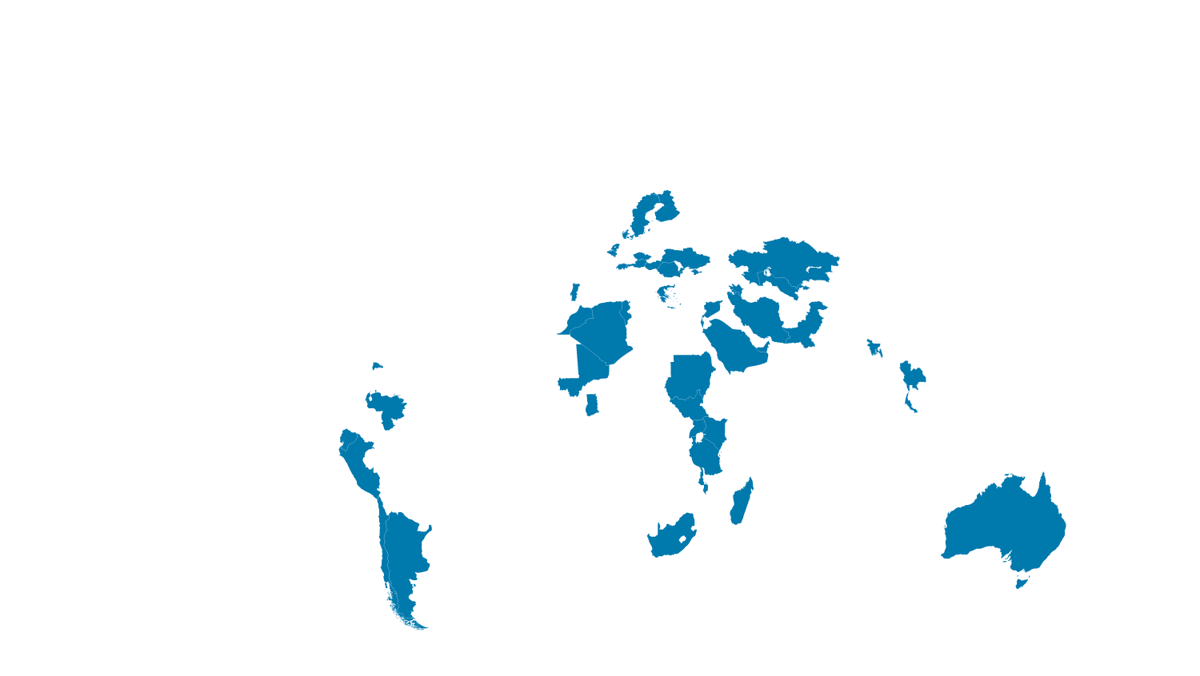

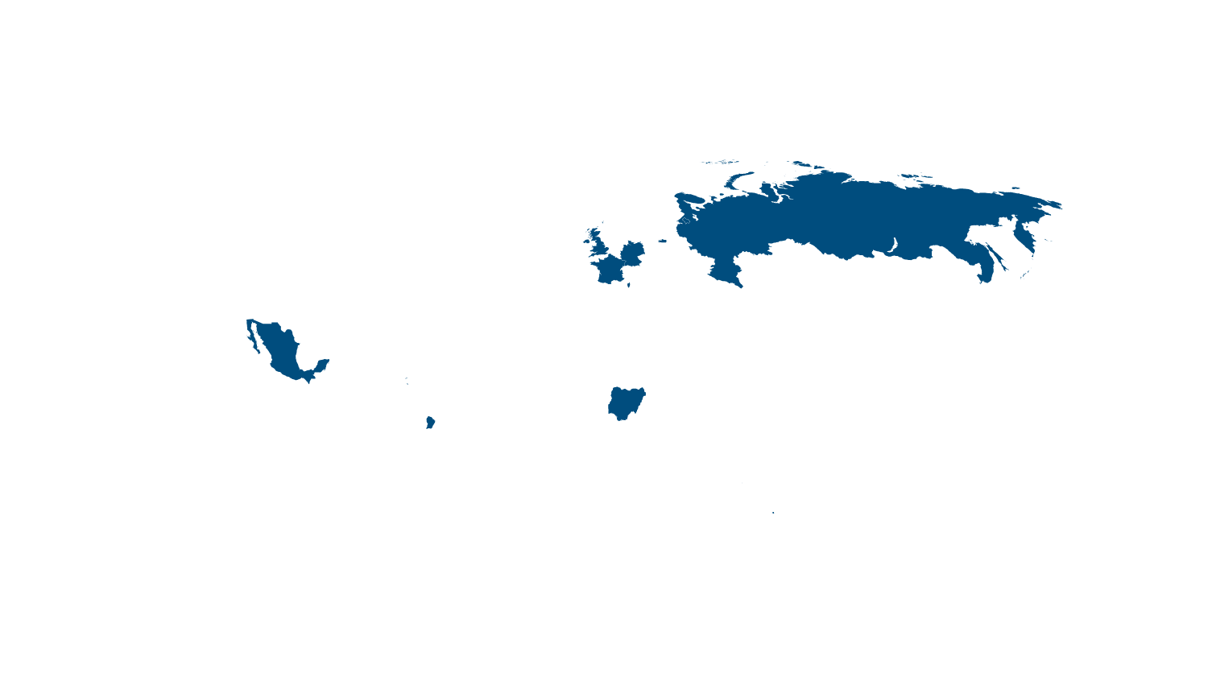


MSFT DRaaS … It’s everywhere!
CANADA CENTRAL
UK SOUTH
CHINA SOUTH
US GOV IOWA
CANADA EAST
UK WEST
WEST EUROPE
GERMANY NORTHEAST
KOREA CENTRAL
GERMANY CENTRAL
CHINA NORTH
KOREA SOUTH
CENTRAL US
JAPAN EAST
WEST US2
INDIA CENTRAL
NORTH CENTRAL US
WEST US
NORTH EUROPE
US DOD EAST
US GOV ARIZONA
US DOD CENTRAL
JAPAN WEST
SOUTH CENTRAL US
EAST US
EAST US2
EAST ASIA
US GOV TEXAS
US GOV Virginia
INDIA SOUTH
WEST CENTRAL US
SOUTHEAST ASIA
AUSTRALIA EAST
BRAZIL SOUTH
AUSTRALIA SOUTHEAST
Recently added

